Slide 1
Week Four– Class One

Slide 2
Destructors
Destructor is an instance member function which is invoked automatically whenever an object is going to be destroyed. Meaning, a destructor is the last function that is going to be called before an object is destroyed.
Destructor is also a special member function like constructor. Destructor destroys the class objects created by constructor.
Destructor has the same name as their class name preceded by a tilde (~) symbol.
It is not possible to define more than one destructor.
The destructor is only one way to destroy the object create by constructor. Hence destructor can-not be overloaded.
Destructor neither requires any argument nor returns any value.
It is automatically called when object goes out of scope.
Destructor release memory space occupied by the objects created by constructor.
In destructor, objects are destroyed in the reverse of an object creation.

Slide 3
How destructors are different from a normal member function?
Destructors are functions with the same name as the class but preceded by a tilde (~)
Several rules govern the declaration of destructors. Destructors:
Do not accept arguments.
Do not return a value (or void).
Cannot be declared as const, volatile, or static. However, they can be invoked for the destruction of objects declared as const, volatile, or static

Slide 4
Can there be more than one destructor in a class? No, there can only one destructor in a class with classname preceded by ~, no parameters and no return type.
When do we need to write a user-defined destructor? If we do not write our own destructor in class, compiler creates a default destructor for us. The default destructor works fine unless we have dynamically allocated memory or pointer in class.

Slide 5
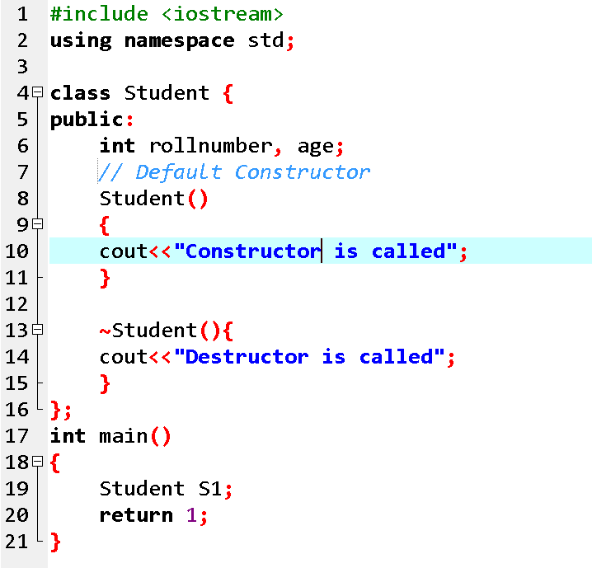
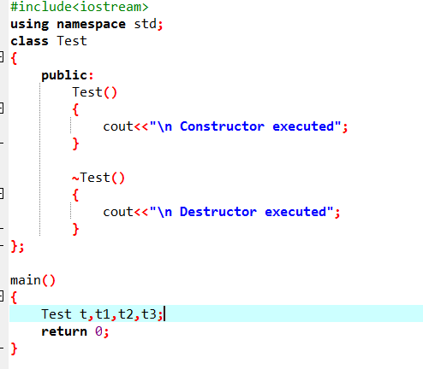

Slide 6
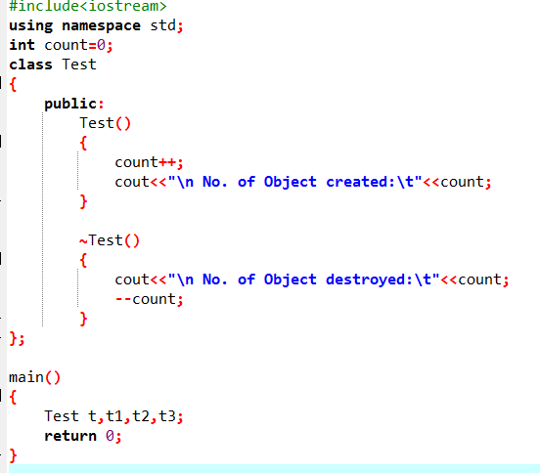

Slide 7
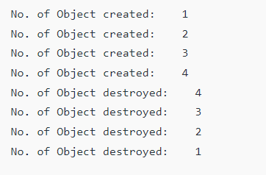

Slide 8
Exercise
Suppose you have a Piggie Bank with an initial amount of $50 and you have to add some more amount to it. Create a class 'AddAmount' with a data member named 'amount' with an initial value of $50. Now make two constructors of this class as follows: 1 - without any parameter - no amount will be added to the Piggie Bank 2 - having a parameter which is the amount that will be added to the Piggie Bank Create an object of the 'AddAmount' class and display the final amount in the Piggie Bank.

Slide 9
Exercise
Write a program in which a class named student has member variables name, roll no, semester and section. Use a parameterized constructor to initialize the variables with your name, roll no, semester and section. Print all data calling some public method and display it.

Slide 10
Default Arguments in C++
A default argument is a value provided in a function declaration that is automatically assigned by the compiler if the caller of the function doesn’t provide a value for the argument with a default value.
Default arguments are overwritten when calling function provides values for them.

Slide 11
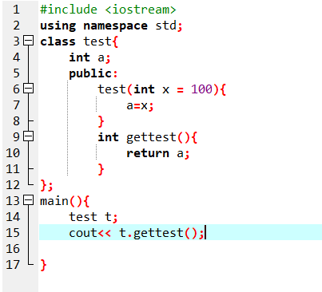
Example
Output is 100

Slide 12
output of the following C++ code?
#include <iostream>
#include <string>
using namespace std;
class A{
int a;
public:
A(int i){
a = i;
}
void assign(int i){
a = i;
}
int value(){
return a;
}
};
int main()
{
A obj;
obj.assign(5);
cout<<obj.value();
}
Error

Slide 13
output of the following C++ code?
#include <iostream>
#include <string>
using namespace std;
class A{
public:
int a;
int b;
public:
A(int i=10,int j=20){
a = i;
b=j;
}
void assign(int i){
a = i;
}
int returnvalue(){
return a;
}
};
int main()
{
A obj;
cout<< obj.a <<obj.b<<endl;
cout<<‘\n';
A obj1(45);
cout<< obj1.a <<obj.b<<endl;
A obj3(10,20);
cout<< obj3.a << obj3.b<<endl;
}

Slide 14
output of the following C++ code?

Slide 15
Initializer List
Initializer List is used in initializing the data members of a class. The list of members to be initialized is indicated with constructor as a comma-separated list followed by a colon.
Syntax: Constructor(int var1 , int var2): Lvaraible1 (var1), Lvaraible12(var2) {}

Slide 16
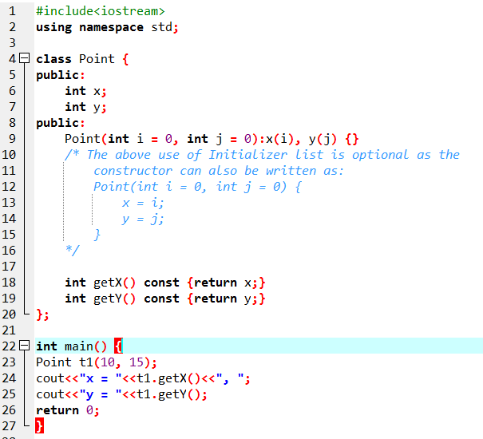
Example

Slide 17
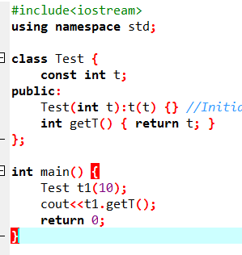
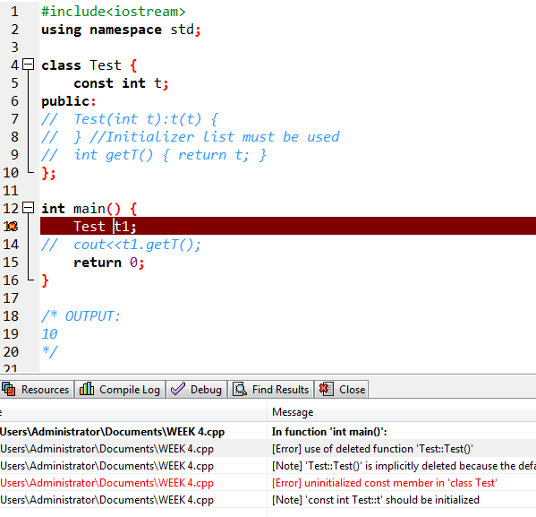
When do we use Initializer List in C++
1. For initialization of non-static const data members
const data members must be initialized using Initializer List.
Reason for initializing the const data member in the initializer list is because no memory is allocated separately for const data member, it is folded in the symbol table due to which we need to initialize it in the initializer list.
Also, it is a Parameterized constructor and we don’t need to call the assignment operator which means we are avoiding one extra operation.

Slide 18
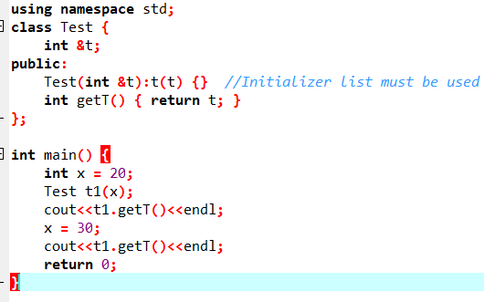
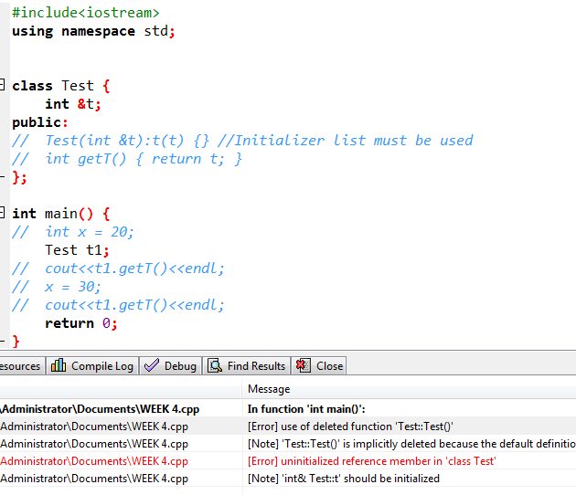
When do we use Initializer List in C++
2. For initialization of reference members
Reference members must be initialized using Initializer List. In the following example, “t” is a reference member of Test class and is initialized using Initializer List

Slide 19
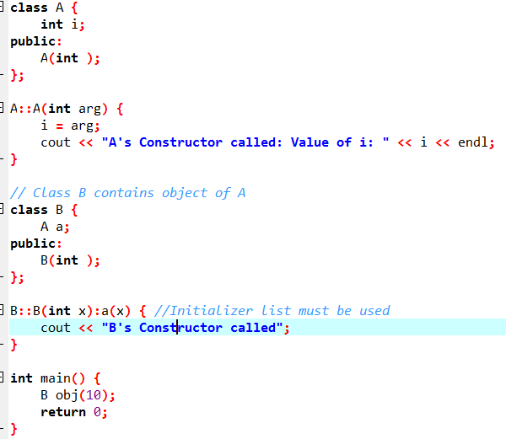
When do we use Initializer List in C++
3. For initialization of member objects which do not have default constructor:

Slide 20
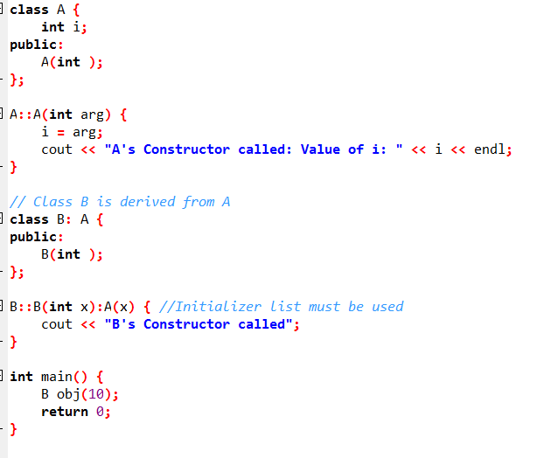
When do we use Initializer List in C++
4. For initialization of base class members

Slide 21
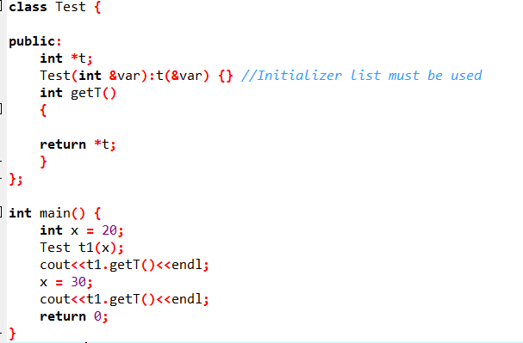
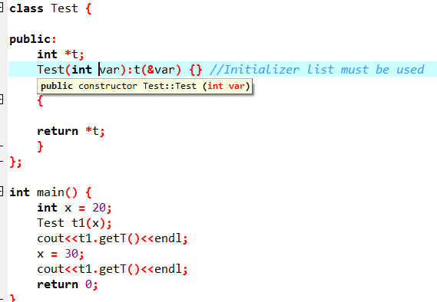
Brain Test

Slide 22
const Keyword in C++
Constant is something that doesn't change.
In C language and C++ we use the keyword const to make program elements constant.
const keyword can be used in many contexts in a C++ program. It can be used with:
Variables
Pointers
Function arguments
Class Data members
Class Member functions
Objects

Slide 23
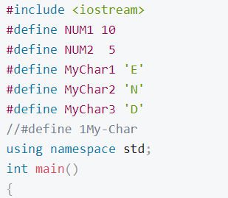
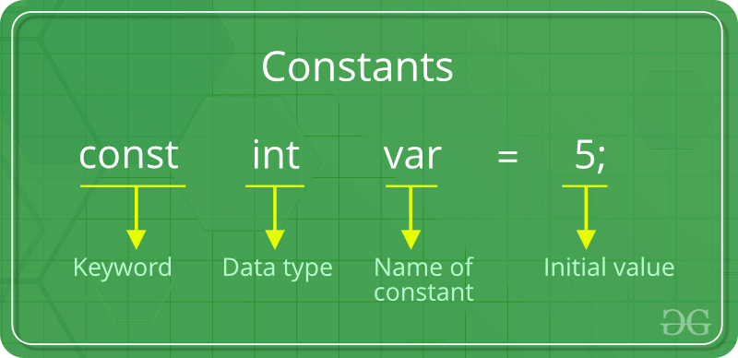
Defining Constants:
In C/C++ program we can define constants in two ways as shown below:
Using #define preprocessor directive
Using a const keyword
#define identifierName value

Slide 24
Why constant?
An advantage of using constants as well as variables may be a small increase in speed when your program runs on a computer.
but it also has the advantage that it makes your programs clearer and easier to understand.
If you declare a constant, you are telling the people who read your program that this value never changes within the program and so whenever it is accessed it will be the same.
The mathematical value π (pi) is a constant value and if you were to use π in your programs you wouldn’t want to have to type out 3.14159 (or more decimal places) every time you needed it, nor would you ever want to give it any other value.

Slide 25
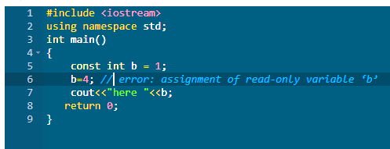

Constant Variables in C++
If you make any variable as constant, using const keyword, you cannot change its value. Also, the constant variables must be initialized while they are declared.

Slide 26
Pointers with const keyword in C++
.
Pointers can be declared using const keyword too.
When we use const with pointers, we can do it in two ways, either we can apply const to what the pointer is pointing to, or we can make the pointer itself a constant.
Pointer point to constant variable.
Pointers to a const variable is very useful, as this can be used to make any string or array immutable(i.e they cannot be changed)
char const* v;
const int* u;

Slide 27
Pointer itself is constant
To make a pointer constant, we have to put the const keyword to the right of the *.
Int x=1;
Int* const w=&x;
Here, w is a pointer, which is const, that points to an int. Now we can't change the pointer, which means it will always point to the variable x but can change the value that it points to, by changing the value of x.
The constant pointer to a variable is useful where you want a storage that can be changed in value but not moved in memory. Because the pointer will always point to the same memory location, because it is defined with const keyword, but the value at that memory location can be changed.
NOTE: We can also have a const pointer pointing to a const variable.
Const int* const x

Slide 28
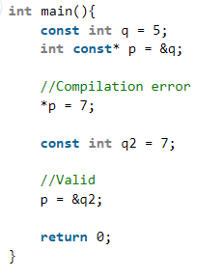
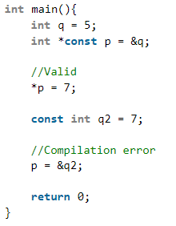
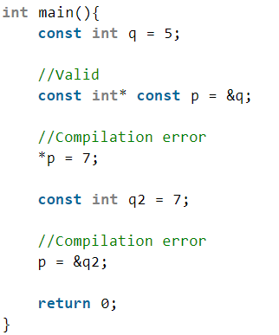
Pointers with const keyword in C++
Int const* ptr
Const int* ptr
Int *const ptr
const int* const

Slide 29
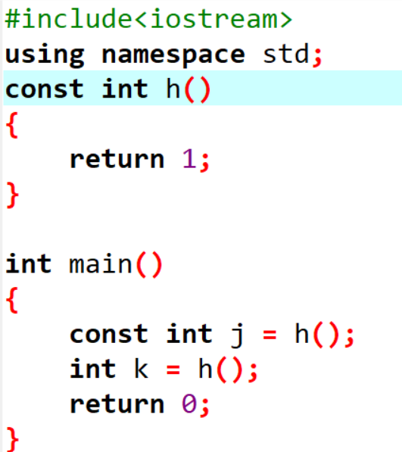
3) Function with constant Arguments
We can make the arguments of a function as const. Then we cannot change any of them.
void f(const int i)
{
i++; // error
}
const int g()
{
return 1;
}

Slide 30
Defining Class Data members as const
.
These are data variables in class which are defined using const keyword. They are not initialized during declaration. Their initialization is done in the constructor.
class Test
{
const int i;
public:
Test(int x):i(x)
{
cout << "\ni value set: " << i;
}
};
int main()
{
Test t(10);
Test s(20);
}

Slide 31
Defining Class Object as const
When an object is declared or created using the const keyword,
its data members can never be changed, during the object's lifetime.
Syntax:
const class_name object;

Slide 32
Defining Class's Member function as const
A const member function never modifies data members in an object.
Syntax:
return_type function_name() const;

Slide 33
Example for const Object and const Member function
class StarWars{
public:
int i;
StarWars(int x)
{ i = x; }
int falcon() const {
cout << "Falcon has left the Base";
}
int gamma()
{ i++;}
};
int main()
{
StarWars objOne(10); // non const object
const StarWars objTwo(20); // const object
objOne.falcon(); // No error
objTwo.falcon(); // No error
cout << objOne.i << objTwo.i;
objOne.gamma(); // No error
objTwo.gamma(); // Compile time error
}

Slide 34
mutable Keyword
mutable keyword is used with member variables of class, which we want to change even if the object is of const type. Hence, mutable data members of a const objects can be modified.

Slide 35
Example: Mutable
class Zee
{
int i;
mutable int j;
public:
Zee()
{
i = 0;
j = 0;
}
void fool() const
{
i++; // will give error
j++; // works, because j is mutable
}
};
int main()
{
const Zee obj;
obj.fool();
}

